Slide 1


E-Commerce Website
Presented by
K Yaswanth Kumar
21691A05P5
III CSE-D

Slide 2

OUTLINE:
1. Company Overview
2.Abstract
3. Introduction:
*Web Development
*Technologies of web development
* Importance of web development
4. E-Commerce Website
5.Algorithm
6.Conclusion

Slide 3

Company Overview:
Legal Name: Internpe
Headquarters: Jaipur, Rajasthan
Founding Date:2022
Internpe is a company, which is non profitable, and only focuses on learner’s dreams. Internpe offers a very economic and pocket friendly course in low prices. This organisation aims to spread knowledge in very efficient way.

Slide 4

Abstract:
Shop Swift is not just an e-commerce platform; it's a lifestyle destination designed to elevate our shopping experience. With an extensive product range, cutting-edge technology, and a customer-centric approach, I have made the way we shop online. Experience the thrill of swift and efficient browsing, aided by our intuitive interface and lightning-fast load times. My innovative cart system remembers our preferences and suggests complementary products, making our shopping journey personalized and efficient. Rest easy with robust security protocols ensuring that our transactions are safe and our data is protected. Unlock a world of savings with exclusive deals and offers, providing us with the best value for our money. Created a personalized wish list, easily shareable with friends and family, and keep track of our favourite products for future purchases.

Slide 5
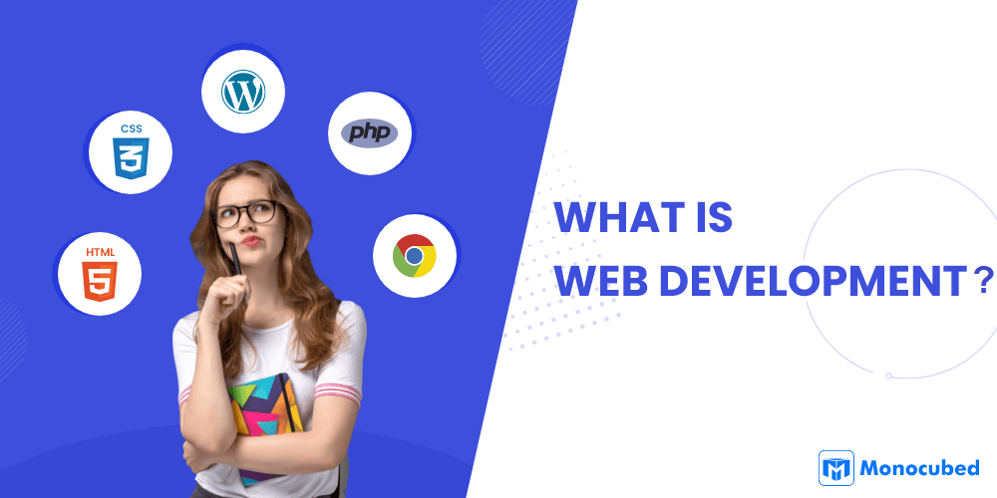
Web development is the dynamic field responsible for building and maintaining websites and web applications. It encompasses both front-end development, focusing on the user interface and user experience, and back-end development, handling the server-side logic and databases. With the ever-increasing importance of an online presence, web development has become a fundamental skill in the digital age.

Slide 6





Technologies in Web Development:
* HTML
* CSS
* JavaScript
* ReactJS

Slide 7
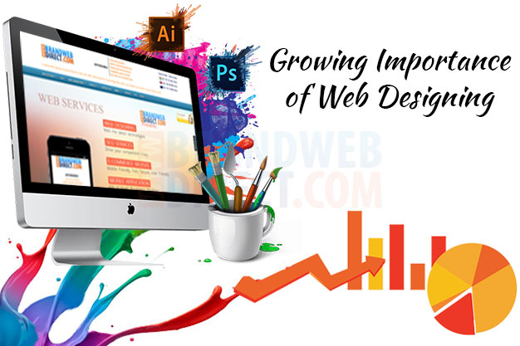
IT BRINGS BUSINESSES TO LIFE
IT’S A WAY OF BUILDING RELATIONSHIPS WITH CUSTOMERS
IT’S A WAY OF CREATING MORE LEADS AND SALES
IT’S A WAY OF DIFFERENTIATING YOUR BUSINESS FROM COMPETITORS
IT’S A WAY OF INCREASING TRAFFIC, ENGAGEMENT AND CONVERSION RATES FOR A WEBSITE
IT CAN HELP INCREASE BRAND AWARENESS AND LOYALTY AMONG EXISTING CUSTOMERS

Slide 8
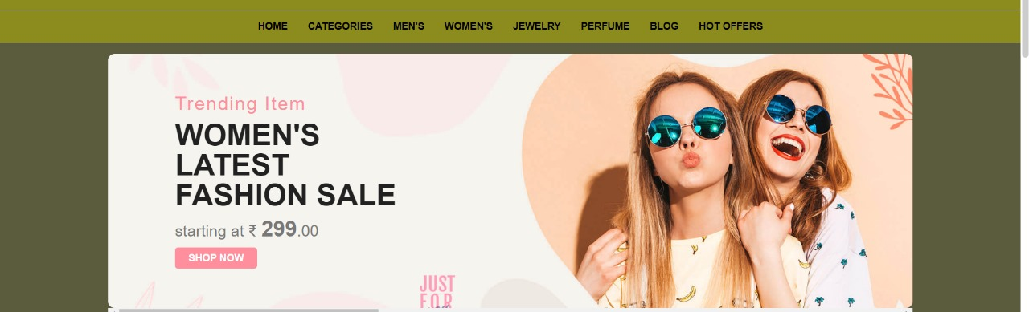
E-Commerce Website
An e-commerce website is one that allows people to buy and sell physical goods, services, and digital products over the internet rather than at a brick-and-mortar location. Through an e-commerce website, a business can process orders, accept payments, manage shipping and logistics, and provide customer service.

Slide 9
Types of E-Commerce Websites
Business-to-Consumer (B2C):Most common type where businesses sell products or services directly to consumers.
Business-to-Business (B2B):Involves transactions between businesses, where one business sells products or services to another business.
Consumer-to-Consumer (C2C):Facilitates transactions between individual consumers, often through online marketplaces.
Consumer-to-Business (C2B):Involves individual consumers selling products or services to businesses.

Slide 10

Algorithm:
1. Create the HTML structure:
- Define the HTML document structure with `<html>`, `<head>`, and `<body>` elements.
- Include meta tags for character encoding and viewport settings.
- Set the document title.
- Define an external CSS style to style the calculator and output area.
2. CSS Styles (styles.css):
The CSS file styles the HTML elements, making the website visually appealing and responsive. Defines styles for the header, main content, shopping cart, and footer.

Slide 11
3. JavaScript Logic (main.js): The JavaScript file adds dynamic behaviour to the website, making it interactive. Fetches product data, displays products, handles shopping cart operations, and more.
4. Integration and Interaction: The HTML file links to the CSS and JavaScript files, integrating the styles and dynamic functionality into the web page. JavaScript interacts with HTML elements by manipulating the Document Object Model (DOM).Event listeners are used to respond to user actions, such as clicking a button to add an item to the shopping cart.
5. Dynamic Content and Interaction: JavaScript dynamically updates the content of the webpage based on user interactions and data from the server (simulated in this case).The shopping cart is updated in real-time, and product details may be displayed in modals or other interactive elements.

Slide 12
6. Testing: The website is thoroughly tested across different browsers and devices to ensure a consistent and user-friendly experience.
7. Deployment: Once satisfied with the development and testing, the website is deployed to a hosting environment accessible to users.
This step-by-step process provides a basic overview of how HTML, CSS, and JavaScript work together to create a functional e-commerce website on the front end.

Slide 13
Conclusion:
The development of the e-commerce website using HTML, CSS, and JavaScript has been a comprehensive journey encompassing various aspects of web development. The project aimed to create a user-friendly and visually appealing platform for online shopping, adhering to modern design principles and responsive web practices. The website prioritizes a user-centric design, providing an intuitive and seamless experience for visitors. Utilizing responsive design techniques ensures the website is accessible and functions well across diverse devices and screen sizes.

Slide 14
Thank You

